Slide 1
Advances in Bioinformatics: Multi-Omics Integration
Session 1: Foundations for Understanding Multi-Omics Research Bioinformatics Journal Club

Slide 2
Welcome to the Multi-Omics Integration Series
In this foundational session, we will establish:
Core concepts: What each omics layer measures and why it matters
Study design frameworks: Parallel vs joint profiling approaches
Analytical paradigms: Sample-focused vs feature-focused integration
Key challenges that will frame upcoming speaker presentations
Goal: Prepare you to critically engage with cutting-edge multi-omics research from UF and external investigators.

Slide 3
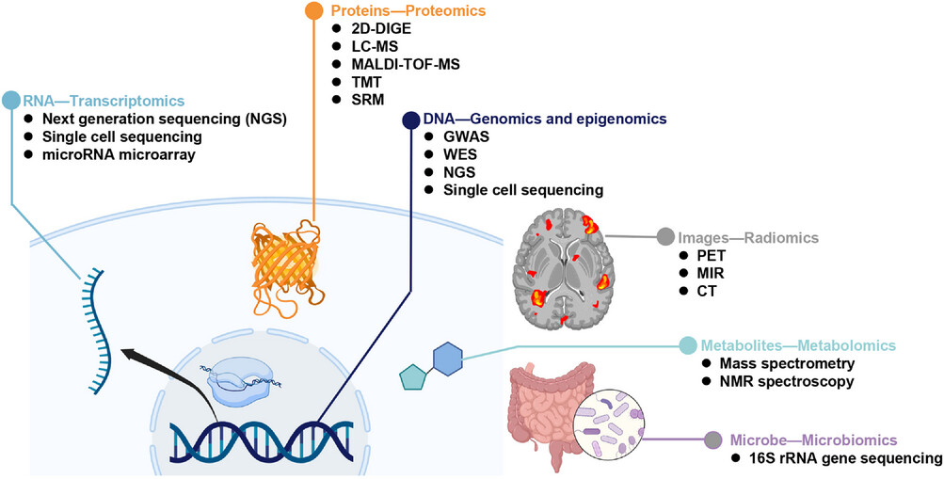
What Is Multi-Omics Integration?
Multi-omics integration combines measurements from multiple molecular layers of the same biological system to reveal regulatory relationships, functional states, and disease mechanisms invisible to single-layer analysis.
Central principle: Biological regulation operates across molecular layers—each omics modality captures one view of this connected system.
Conceptual overview of multi-omics data types

Slide 4
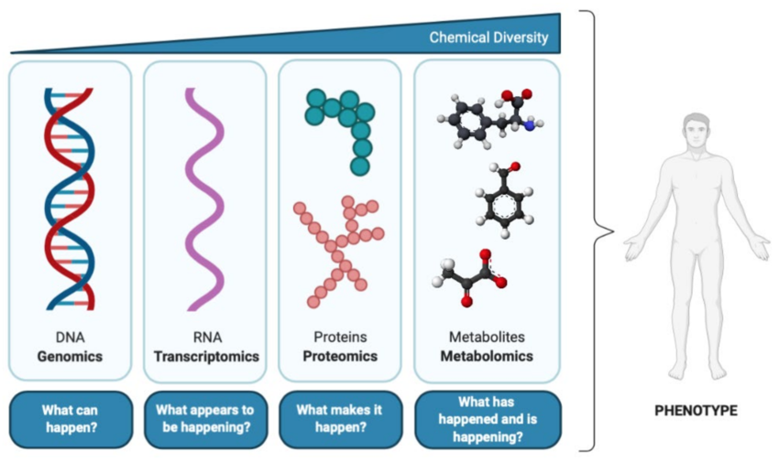
The Multi-Layered Biology of Cells
Genome → Epigenome → Transcriptome → Proteome → Metabolome
Each layer represents a different level of biological organization
Regulation flows across layers but is not strictly linear
Feedback loops and post-transcriptional control create complex layer-to-layer relationships
Why multi-omics? Single-layer measurements answer “what is present?” Multi-omics answers “what is active, regulated, and functional?”
Multi-layer information flow from genome to metabolome

Slide 5
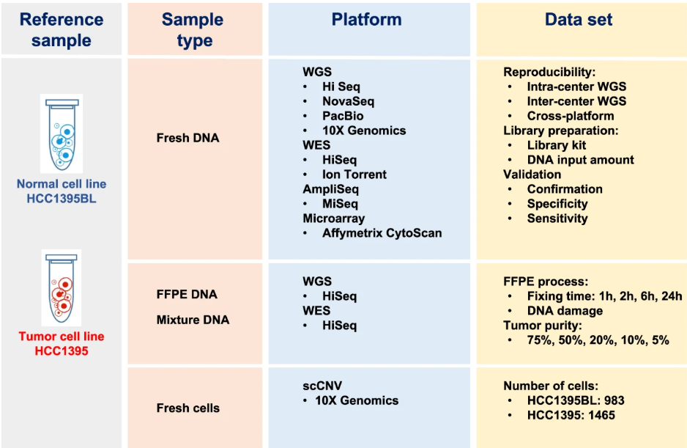
Genomics: The Blueprint
What it measures: DNA sequence variation including germline and somatic mutations, copy number alterations, and structural rearrangements
Common technologies: - Whole-genome sequencing (WGS) - Whole-exome sequencing (WES) - Targeted gene panels
Genomics technology comparison across platforms and study designs

Slide 6
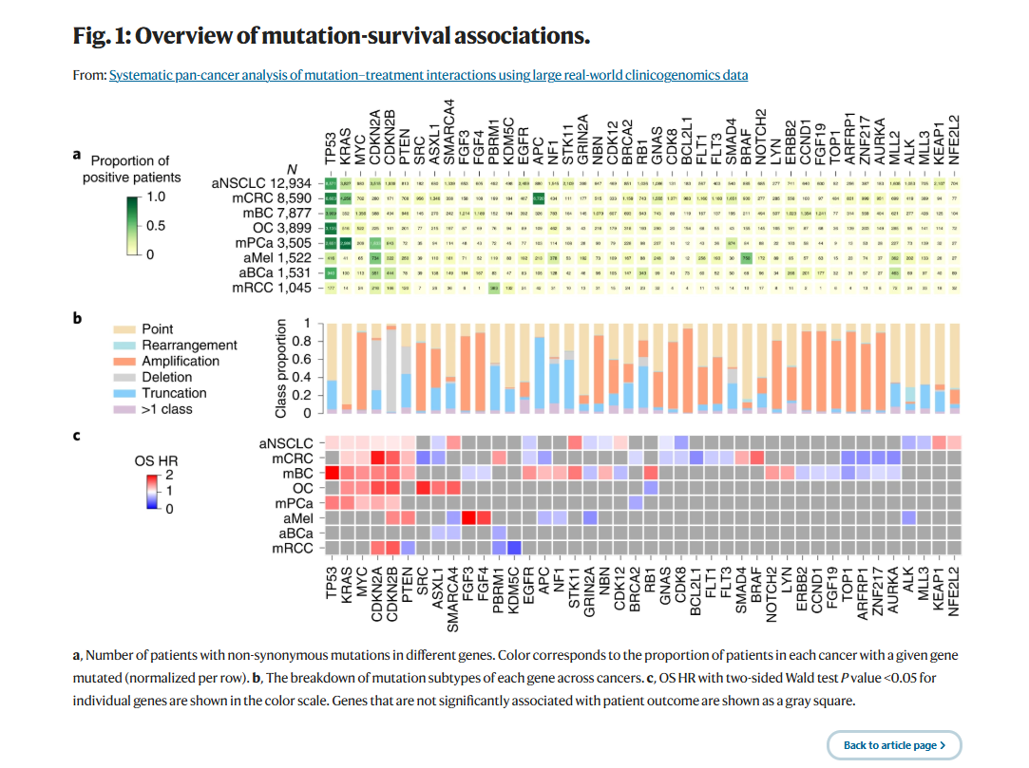
Genomics: Mapping Drivers and Vulnerabilities
Key insight: Genomics identifies recurrent driver alterations across cancer types and reveals mutation mechanisms (point mutations, amplifications, deletions).
What genomics tells us: - Cancer susceptibility and clonal evolution - Targetable alterations and resistance mechanisms
What it doesn’t tell us: Whether mutated pathways are transcriptionally active, whether proteins are expressed, or how the regulatory environment shapes phenotype.
Takeaway: Genomics defines potential—integration with other layers reveals realized biology.
TCGA pan-cancer mutation landscape

Slide 7
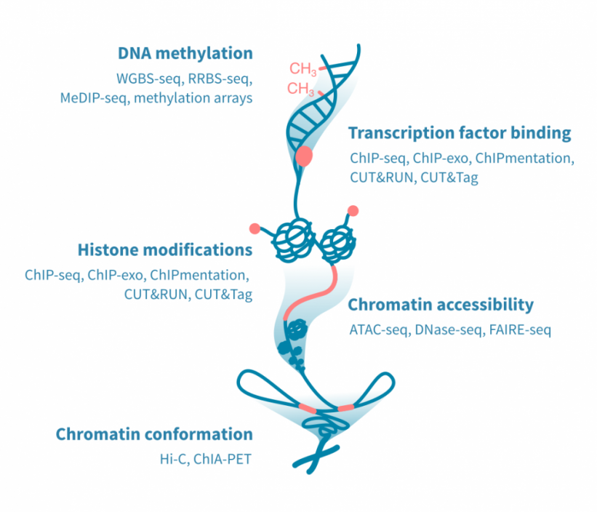
Epigenomics: The Regulatory Layer
What it measures: Chromatin state and DNA modifications that control gene accessibility without altering DNA sequence
Common technologies: - ATAC-seq (chromatin accessibility) - ChIP-seq / CUT&RUN (transcription factor binding, histone modifications) - Bisulfite sequencing (DNA methylation: WGBS, RRBS)
Epigenomics assay types and their biological readouts

Slide 8
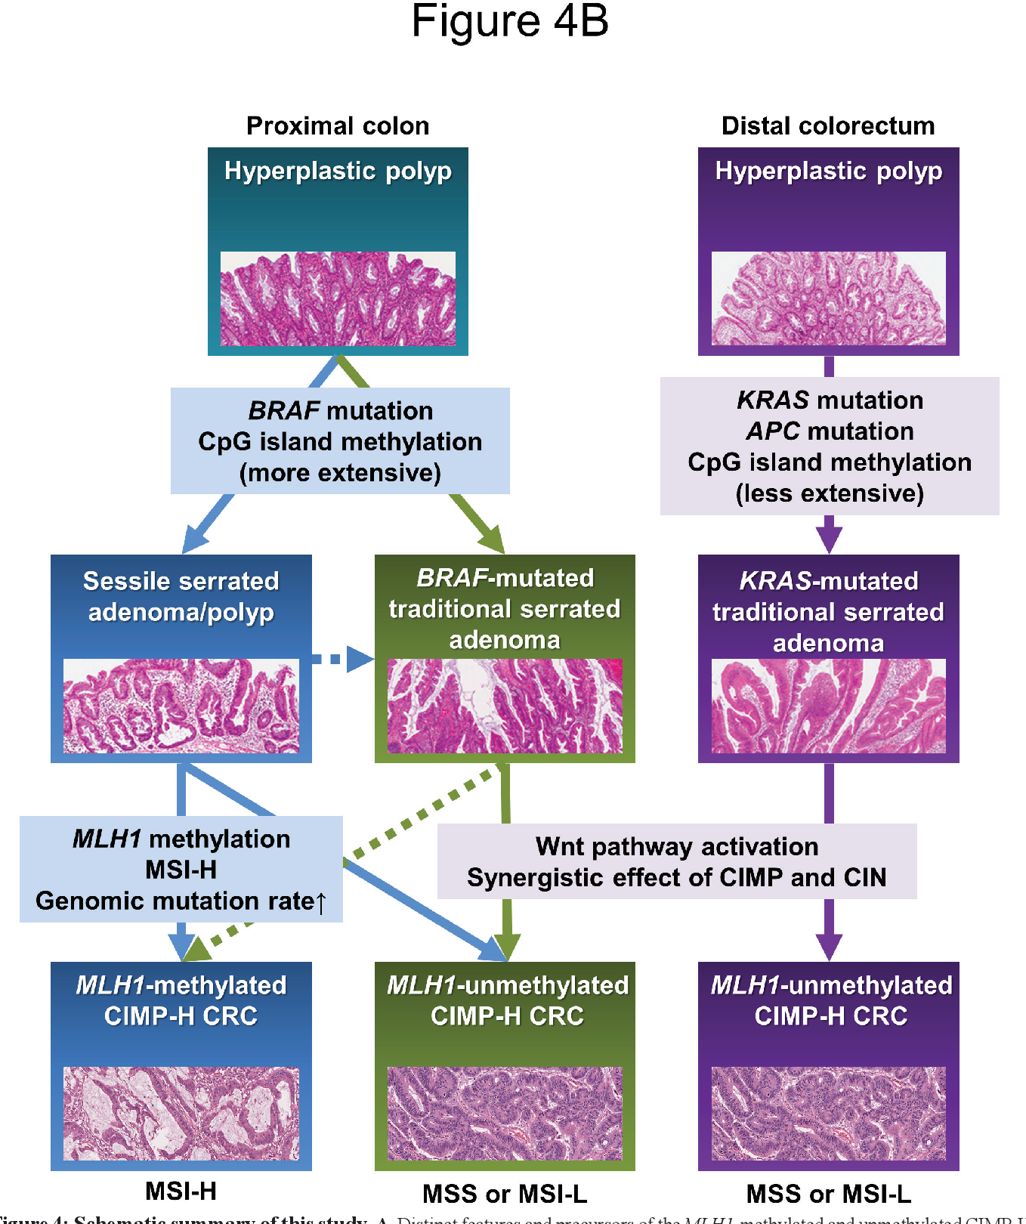
Epigenomics: Mechanisms of Transcriptional Control
Key insight: DNA methylation at CpG islands can silence tumor suppressors independently of mutation, defining distinct molecular and clinical subtypes.
What epigenomics tells us: - Which genes are poised for expression vs silenced - Cell identity and lineage commitment - Regulatory mechanisms underlying phenotype switching
Takeaway: Epigenomics reveals regulatory potential—which parts of the genome are accessible and how transcription factors can act. Integration with transcriptomics distinguishes potential from realized activity.
CpG island methylator phenotype in colorectal cancer

Slide 9
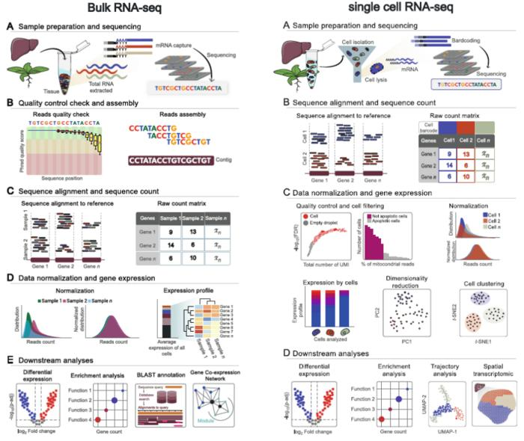
Transcriptomics: Active Gene Expression
What it measures: RNA abundance reflecting active transcriptional programs
Common technologies: - Bulk RNA-seq (population average) - Single-cell RNA-seq (cell-level resolution) - Spatial transcriptomics (tissue architecture)
Transcriptomics technology comparison

Slide 10
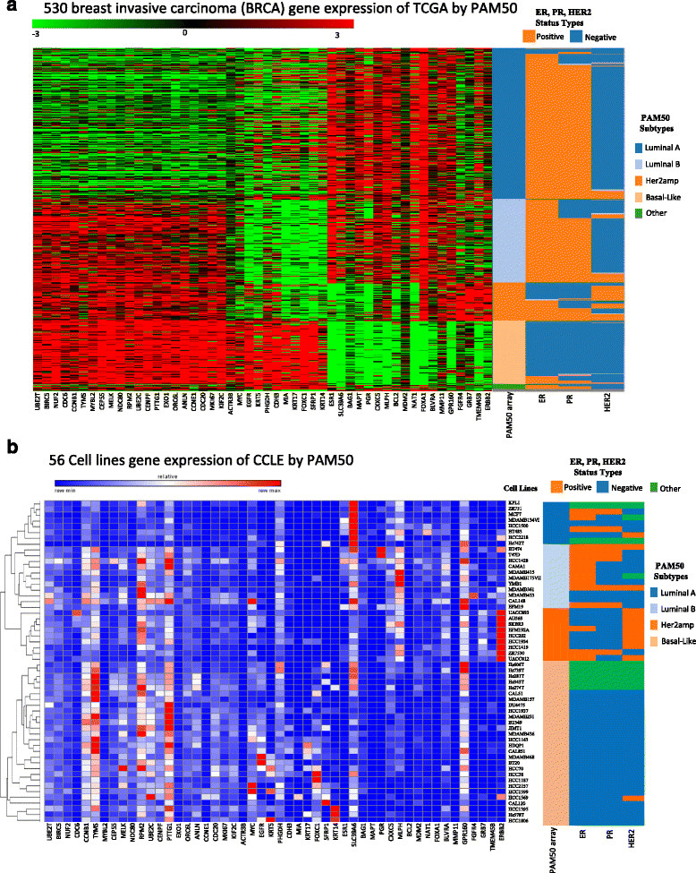
Transcriptomics: Defining Cellular States and Subtypes
Key insight: Expression-based classification (PAM50) identifies breast cancer subtypes with distinct biology and clinical behavior, independent of receptor status alone.
What transcriptomics tells us: - Active signaling pathways and regulatory programs - Cell states, heterogeneity, and tumor microenvironment composition - Molecular subtypes with therapeutic relevance
Limitation: RNA abundance ≠ protein abundance ≠ activity. Post-transcriptional regulation and protein stability decouple mRNA from functional output.
Takeaway: Transcriptomics captures gene expression programs but requires integration with proteomics to understand functional consequences.
PAM50 breast cancer subtypes based on gene expression

Slide 11
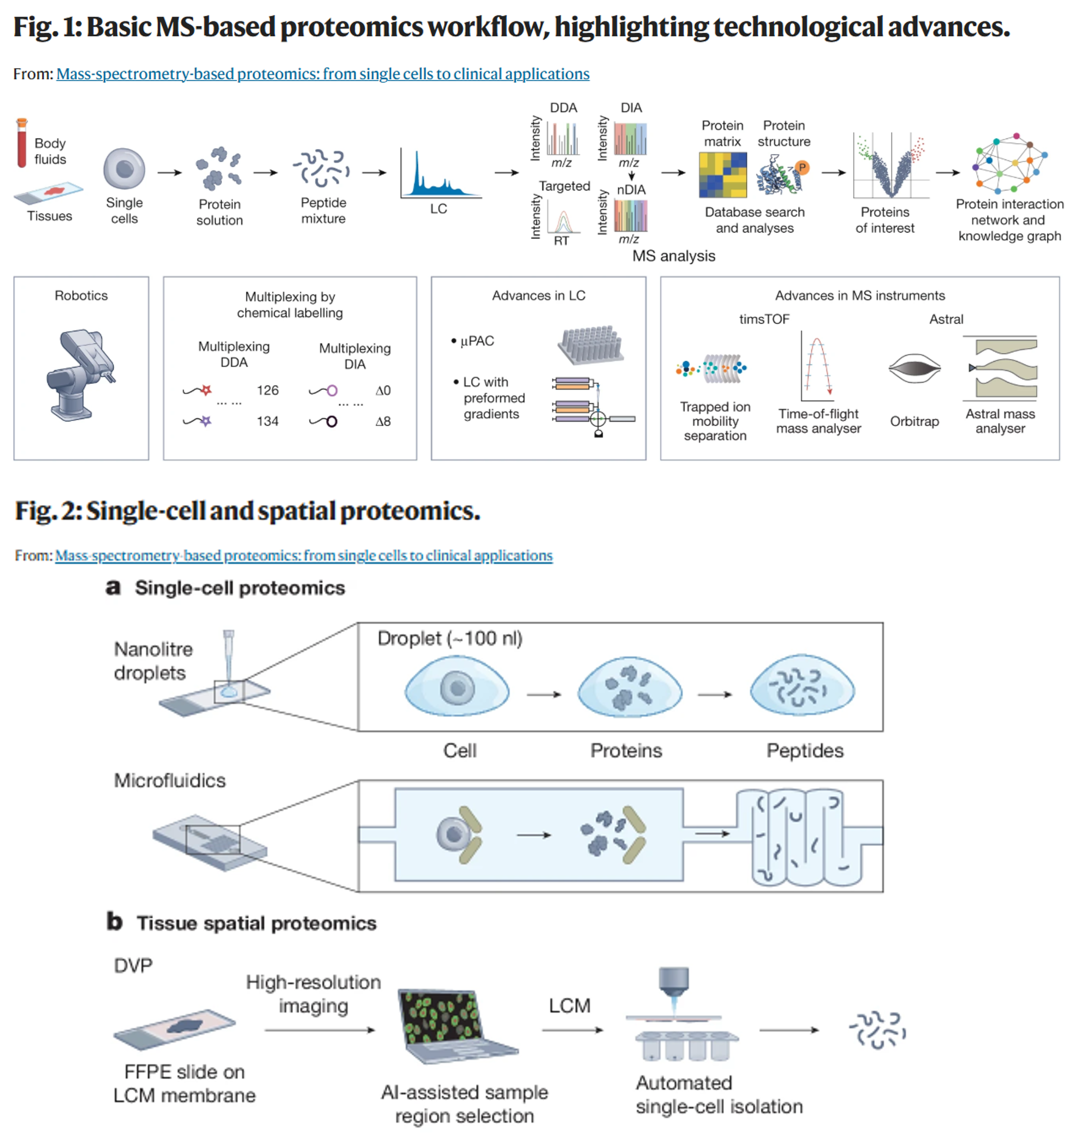
Proteomics: The Functional Machinery
What it measures: Protein abundance, post-translational modifications, and interactions—the direct effectors of cellular function
Common technologies: - Mass spectrometry–based proteomics (discovery, targeted) - Antibody-based platforms (RPPA, CyTOF)
Proteomics workflow and technology platforms

Slide 12
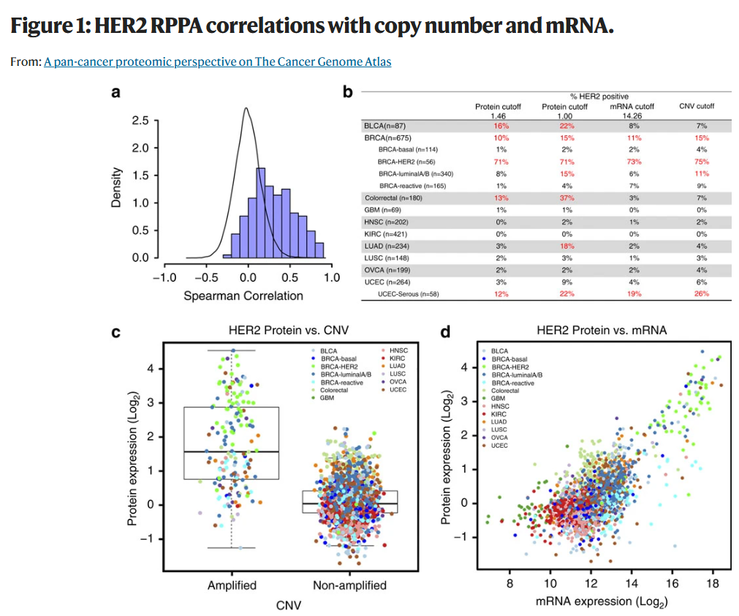
Proteomics: From Measurement to Clinical Action
Key insight: HER2 classification varies dramatically by layer. RNA-protein correlation is only 0.53. Samples classified as HER2-positive by protein may be negative by RNA or copy number.
What proteomics tells us: - Functional protein levels for therapy decisions (e.g., anti-HER2 treatment) - Post-transcriptional regulation and protein stability effects - Discordance between genomic/transcriptomic potential and protein reality
Takeaway: For many clinical decisions, protein measurement is essential. Discordance across layers motivates multi-omics integration to capture the full regulatory cascade from DNA → RNA → protein.
HER2 assessment across genomic, transcriptomic, and proteomic layers

Slide 13
Metabolomics: Biochemical Activity and Regulation
What it measures: Small molecules reflecting metabolic flux, enzymatic activity, and microenvironmental conditions
Common technologies: - Liquid/gas chromatography coupled with mass spectrometry (LC-MS, GC-MS) - Targeted vs untargeted metabolomics - Nuclear magnetic resonance (NMR) spectroscopy
Metabolomics experimental workflow

Slide 14
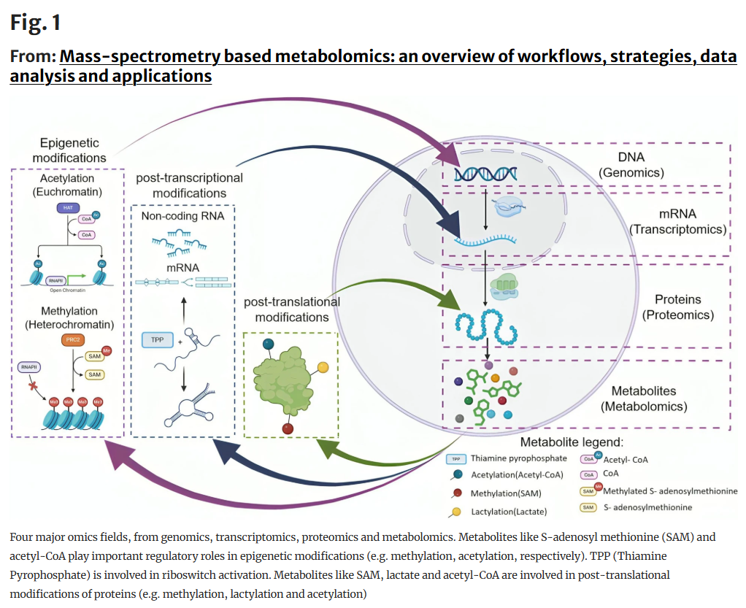
Metabolomics: Connecting Metabolism to Regulation
Key insight: Metabolites are not just endpoints—they are regulatory signals. S-adenosylmethionine (SAM) drives DNA and histone methylation; acetyl-CoA enables histone acetylation; lactate modifies protein function.
What metabolomics tells us: - How metabolic state regulates gene expression through epigenetic modifications - Phenotype-proximal biology (closer to observable disease than genomics) - Metabolic reprogramming in cancer and immune cells
Takeaway: Metabolomics reveals bidirectional regulation: metabolism shapes epigenetics and protein function, creating feedback loops across omics layers. This motivates integrative analysis to capture systems-level regulation.
Metabolites as regulatory molecules connecting omics layers

Slide 15
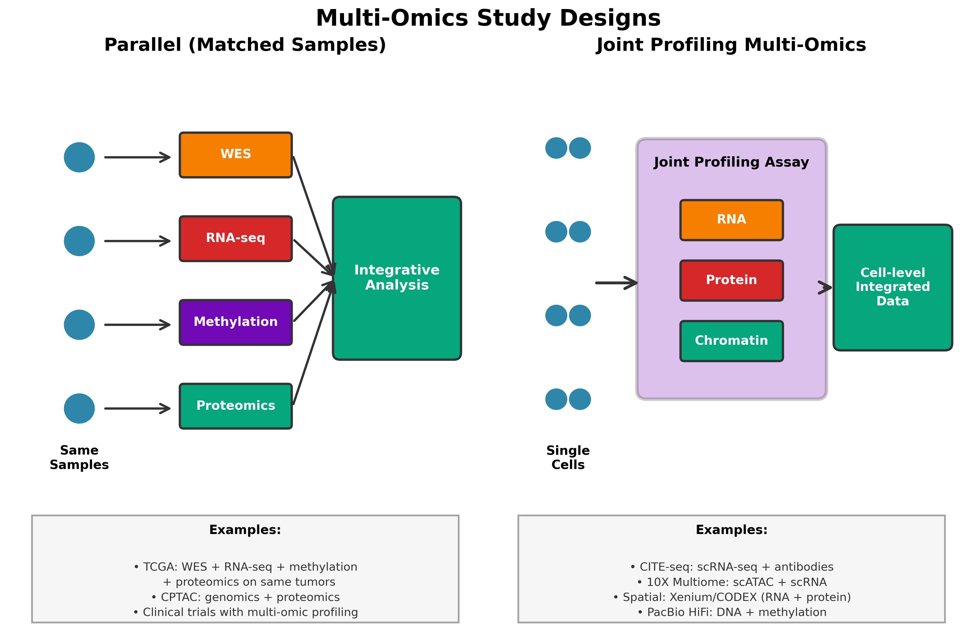
Two Paradigms for Multi-Omics Studies
Parallel Multi-Omics (Matched Samples): - Multiple omics measured on the same samples (e.g., tumor aliquots) - Enables direct layer-to-layer correlation and integration - Examples: TCGA, CPTAC
Joint Profiling Multi-Omics: - Multiple omics measured from the same cells or spatial locations - Requires specialized single-cell or spatial technologies - Examples: CITE-seq (scRNA + protein), 10X Multiome (scATAC + scRNA), spatial metabolomics + transcriptomics
Why this distinction matters: Different technologies enable different biological questions and require different integration approaches.
Schematic showing parallel vs joint profiling multi-omics

Slide 16
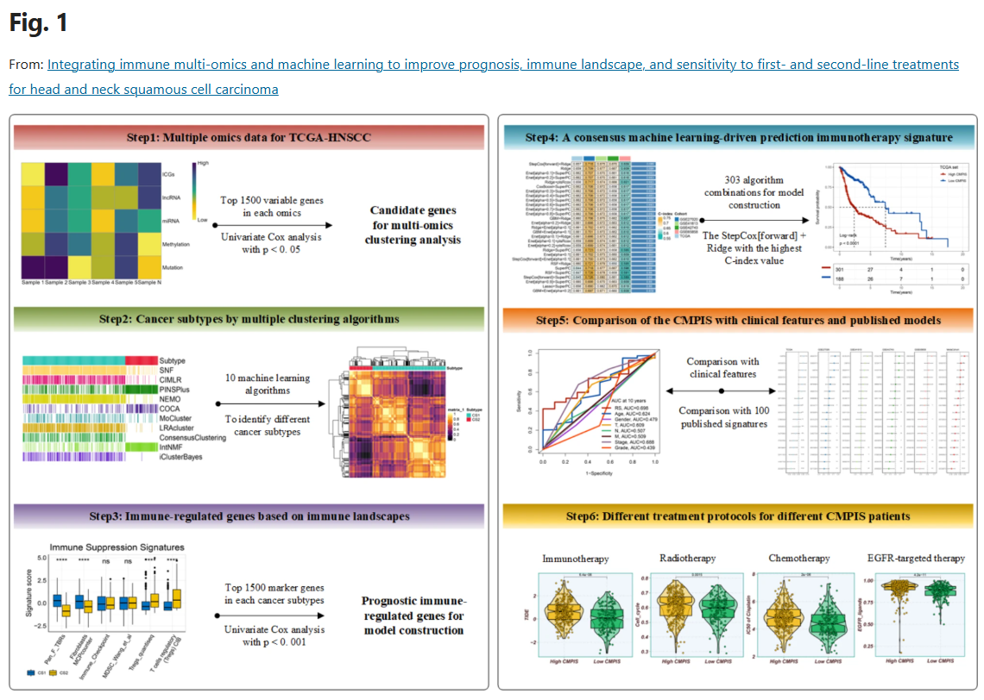
Parallel Multi-Omics: Integrating Matched Tumor Profiles
Study design: Multi-platform profiling of the same tumor samples (WES, RNA-seq, methylation, proteomics) to link molecular alterations to clinical outcomes.
Key findings: - Mutation-expression relationships reveal functional consequences of genomic alterations - Multi-omics subtypes better predict treatment response than single-layer classification - Integration identifies which genomic drivers are transcriptionally/proteomically active
Takeaway: Parallel multi-omics on matched samples enables direct integration across layers, revealing which molecular alterations drive phenotype and which are passenger events.
TCGA-based study integrating genomics, transcriptomics, and outcomes

Slide 17
Joint Profiling Technologies: Single-Cell Multi-Omics
Omics Combination | Example Technologies
Genome + Transcriptome | G&T-seq, SCTG, DR-seq, TARGET-seq, sci-L3-RNA/DNA, scONE-seq
Epigenome + Transcriptome | scCAT-seq, sci-CAR, SNARE-seq, SHARE-seq, ASTAR-seq, Paired-Tag
Transcriptome + Protein | REAP-seq, CITE-seq, ASAP-seq
Transcriptome + CRISPR Perturbations | Perturb-seq, CROP-seq
Epigenome + Protein | ICICLE-seq, ASAP-seq, PHAGE-ATAC
Triple Modality | TEA-seq, DOGMA-seq (RNA + protein + chromatin)

Slide 18
Advantage: Eliminates batch effects and sample heterogeneity—all measurements from the same cells.
Emerging: Spatial multi-omics maintains tissue architecture.

Slide 19
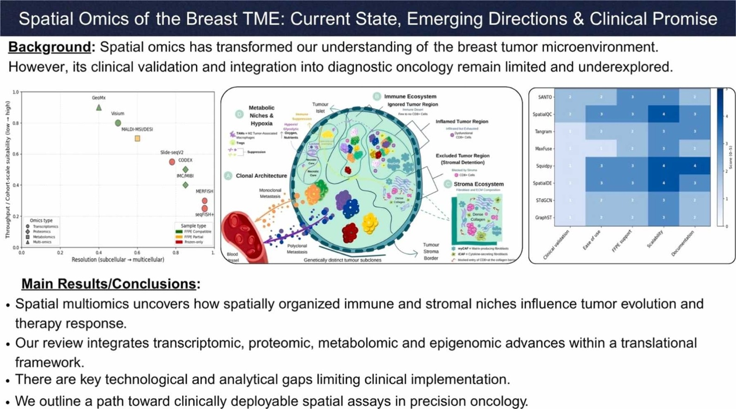
Joint Profiling: Spatial Multi-Omics of Breast Cancer
Study design: Spatial transcriptomics, proteomics, metabolomics, and epigenomics integrated with tissue architecture to map the breast tumor microenvironment.
Key findings: - Spatially organized immune and stromal niches influence tumor evolution - Metabolic gradients within tumors drive spatially distinct transcriptional programs - Integration of modalities reveals cell-cell communication networks
Takeaway: Joint spatial profiling reveals how molecular layers interact within tissue architecture—biology that parallel bulk approaches cannot capture. Clinical promise includes predicting therapy response based on spatial organization.
Spatial multiomics reveals tumor microenvironment organization

Slide 20
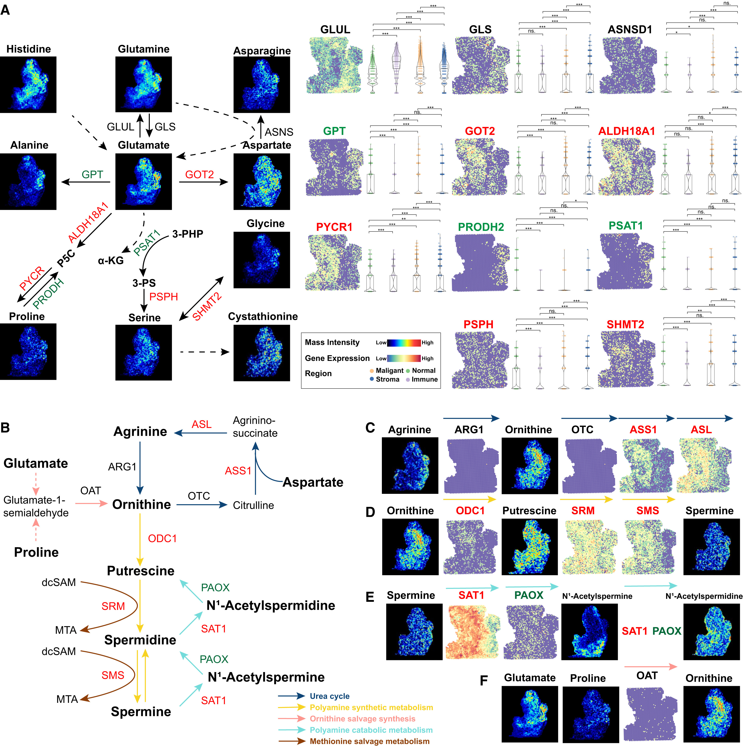
Joint Profiling: Metabolic Reprogramming in Pancreatic Cancer
Study design: Spatial metabolomics integrated with spatial transcriptomics and proteomics to map metabolic rewiring in pancreatic tumors.
Key findings (Panel A): - Serine/glycine metabolism enzymes (GLUL, GLS, ASNS) show spatially distinct expression in tumor vs stroma - Glutamate-derived pathways (GOT2, ALDH18A1) are heterogeneous within the tumor microenvironment
Key findings (Panels B-F): - Sequential metabolic pathways mapped spatially: arginine → ornithine → polyamines - Enzyme expression (ASL, ASS1, ODC1, SRM, SMS) corresponds to metabolite spatial distribution - Integration reveals metabolic compartmentalization between tumor, stroma, and immune regions
Takeaway: Spatial integration of metabolomics, transcriptomics, and proteomics maps metabolic reprogramming at cellular resolution. This reveals tumor-stroma metabolic crosstalk and identifies spatially restricted metabolic vulnerabilities for targeted therapy.
Integrated spatial omics of metabolic reprogramming

Slide 21
Integrative Analysis vs Meta-Analysis
Meta-analysis: - Analyze each omics layer independently - Combine results post-analysis (e.g., pathway enrichment overlap) - Answers: “Do genomic and transcriptomic analyses independently support this pathway?”
Integrative analysis: - Joint statistical modeling across omics layers - Leverages cross-layer structure during analysis (e.g., latent factor models, network inference) - Answers: “Which latent factors or regulatory networks explain coordinated variation across layers?”
Why this distinction matters: - Integration can reveal cross-layer relationships invisible to separate analyses - But integration requires stronger assumptions and careful interpretation - Different methods suit different biological questions

Slide 22
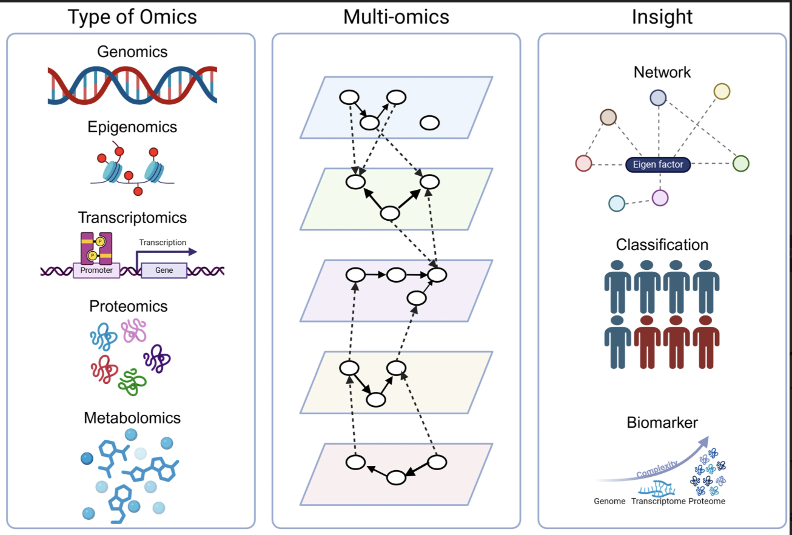
Two Analytical Paradigms for Integration
Multi-omics integration strategies for different goals

Slide 23
Sample-Focused Integration - Goal: Group samples into subtypes - Unit of analysis: Patients/samples - Output: Molecular classifications - Example: Multi-omics cancer subtyping - Methods: Consensus clustering, similarity network fusion
Feature-Focused Integration - Goal: Infer regulatory mechanisms - Unit of analysis: Genes, proteins, metabolites - Output: Networks, regulatory programs - Example: Multi-layer gene regulatory networks - Methods: Network inference, factor analysis
Notes:
The middle panel shows how omics layers contain within-layer relationships (nodes/edges within planes) and cross-layer relationships (dashed lines between planes). Sample-focused integration (bottom right: Classification) clusters samples based on multi-omics similarity, grouping patients into subtypes. Feature-focused integration (top right: Network) connects molecular features across layers to infer mechanisms, shown as networks with latent factors coordinating multiple molecules.

Slide 24
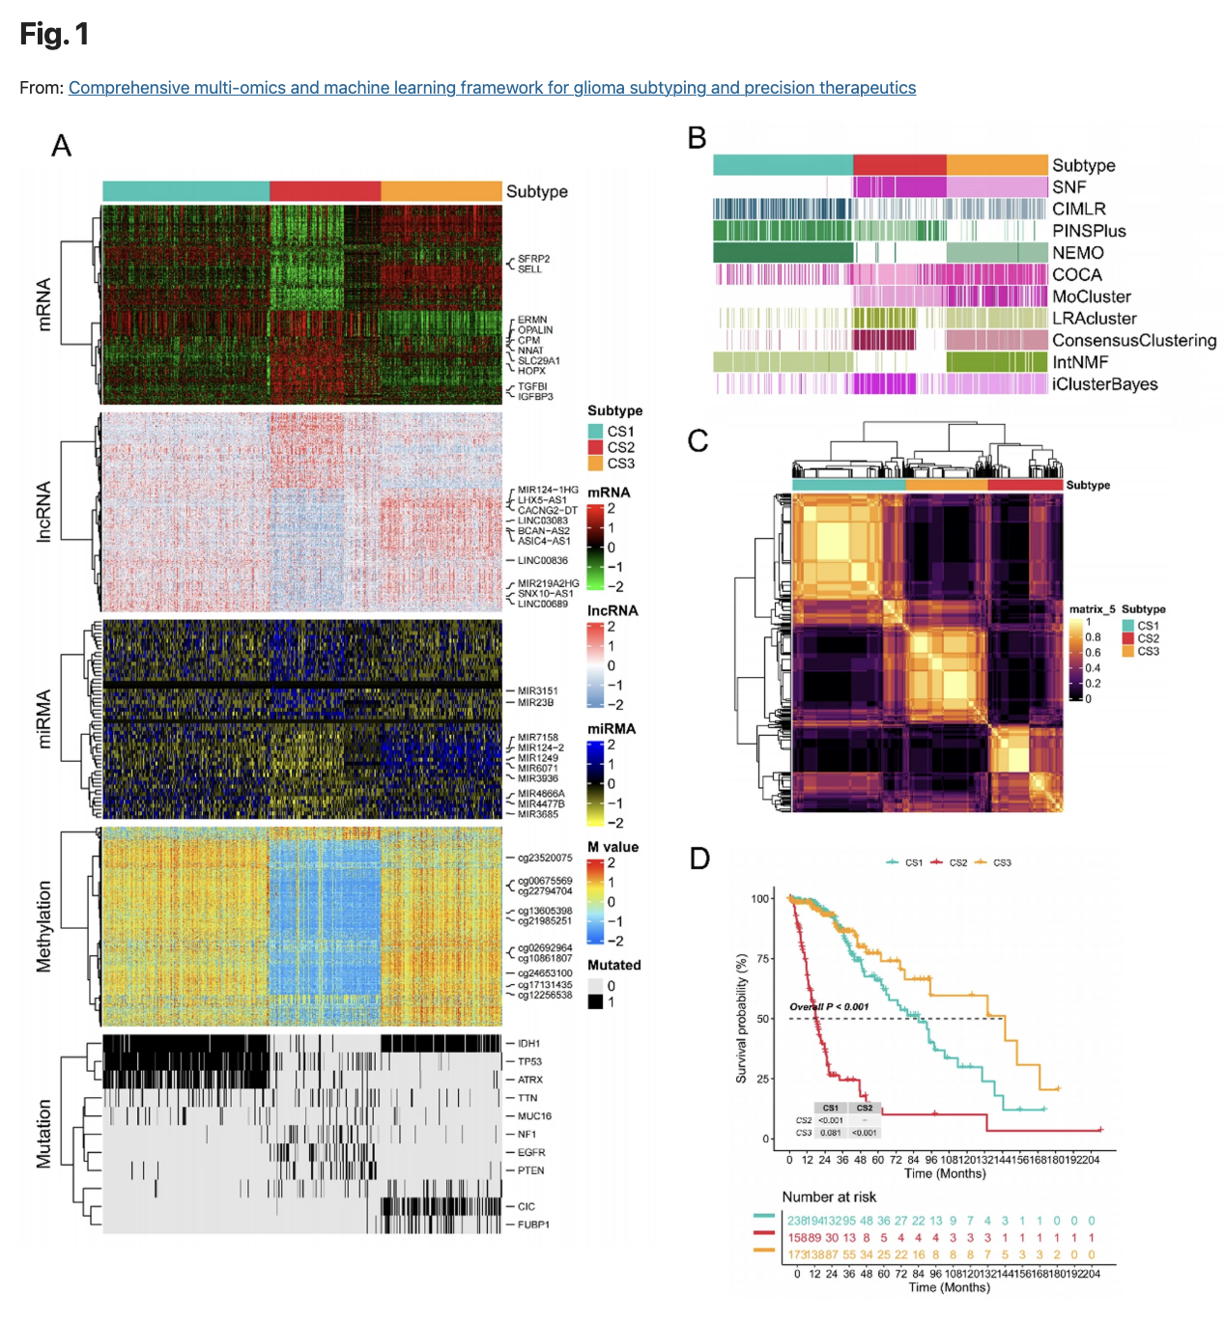
Sample-Focused Integration: Molecular Subtyping
Analytical approach: Consensus clustering integrating mRNA, lncRNA, miRNA, DNA methylation, and mutation profiles to classify glioma patients.
Key findings: - Three molecular subtypes identified with distinct multi-omics signatures (panels A-C) - Subtypes show significantly different survival outcomes (panel D) - Integration provides stronger prognostic stratification than single-omics classification
Takeaway: Sample-focused integration groups patients into clinically meaningful subtypes by leveraging complementary information across omics layers. This approach is critical for precision medicine—identifying which patients will benefit from specific therapies.
Multi-omics clustering identifies glioma subtypes with clinical relevance

Slide 25
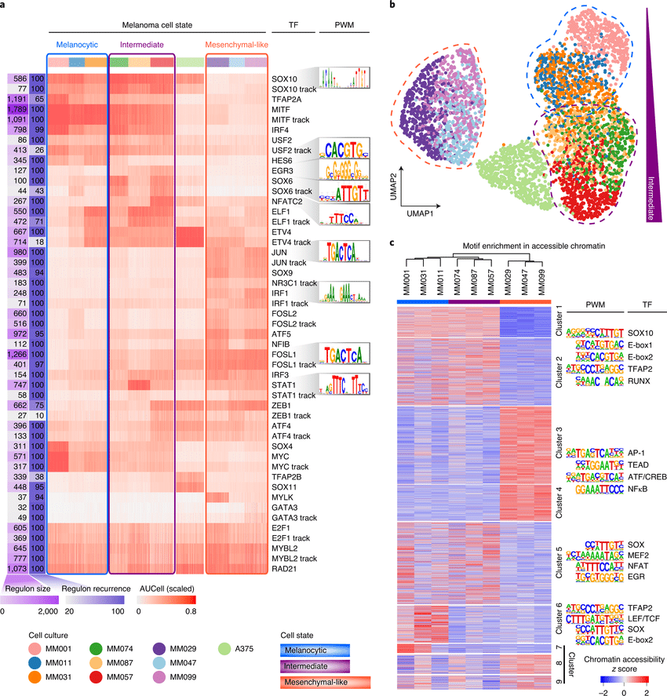
Feature-Focused Integration: Regulatory Networks
Analytical approach: SCENIC integrates scRNA-seq with TF motif analysis and ATAC-seq chromatin accessibility to infer gene regulatory networks governing melanoma cell states.
Key findings: - Panel a: Regulon activity heatmap reveals TF programs distinguishing melanocytic, intermediate, and mesenchymal states - Panel b: UMAP based on regulon activities (not genes) separates intermediate state—regulatory programs define cell identity - Panel c: ATAC-seq validates that predicted TF binding sites are accessible in the corresponding cell states
Takeaway: Feature-focused integration identifies mechanisms—which transcription factors regulate cell state transitions and how chromatin accessibility enables this regulation. This analysis reveals the regulatory logic connecting epigenomics to transcriptomics, impossible to capture from either layer alone.
SCENIC infers TF regulatory networks from multi-omics data

Slide 26
Challenges in Multi-Omics Integration
Having established what multi-omics can reveal, we now consider practical challenges that shape study design and interpretation—challenges that our upcoming speakers will address in their research.
Key challenges:
Layer-to-layer discordance is often the biological signal, not measurement error
Missing data across layers complicates integration and forces modeling assumptions
Batch effects and technical variation differ across platforms
Interpretability decreases as model complexity increases

Slide 27
Discordance Across Layers: Signal or Noise?
Common observations: - RNA–protein correlation is often modest (ρ ~ 0.4–0.6) - Open chromatin without gene expression - Metabolic shifts without transcriptional changes
Critical reframing: > Disagreement across omics layers is often the biological signal—revealing post-transcriptional regulation, protein stability effects, and metabolic control of gene expression.
Example revisited: HER2 protein positivity without RNA overexpression indicates post-transcriptional or protein stability mechanisms, creating distinct therapeutic vulnerabilities.
Implication: Integration methods must distinguish biological discordance from technical noise.

Slide 28
Missing Data in Multi-Omics
Types of missingness: - Missing by design: Not all samples profiled on all platforms (cost, sample limitations) - Missing not at random: Low-abundance proteins/metabolites drop out; depends on biology - Platform-specific dropout: Single-cell RNA-seq has high zeros; proteomics misses low-abundance proteins
Why missingness matters: - Breaks naïve integration methods (e.g., correlation-based approaches) - Requires careful imputation or missingness-aware models - Limits interpretation: Is a feature absent or undetected?
Takeaway: Missing data is a fundamental challenge in multi-omics. Upcoming speakers will discuss how they address missingness in their integration workflows.

Slide 29
Preparing for the Multi-Omics Integration Series
What we’ve established today: - Each omics layer captures a distinct biological view—integration is required to understand regulation and function - Study design choices (parallel vs joint profiling) shape biological questions and analytical approaches - Analytical paradigms (sample-focused vs feature-focused) serve different goals: classification vs mechanism - Challenges like layer-to-layer discordance and missing data are inherent to multi-omics biology
Looking ahead in this series: - UF and external researchers will present cutting-edge multi-omics methods and applications - You’ll see how investigators address the challenges discussed today in real-world contexts - We’ll explore advanced integration methods, single-cell/spatial multi-omics, and clinical translation
Questions to carry forward: How do we distinguish biological signal from technical noise across layers? When should we integrate vs analyze separately? How do we make multi-omics findings actionable?

Slide 30
Questions and Discussion
What questions do you have about multi-omics concepts, study designs, or analytical approaches?
What multi-omics applications are most relevant to your research?

